Slide 1

K I S S
The key principle for managing data-limited fisheries?
Doug Butterworth and Helena Geromont
MARAM (Marine Resource Assessment and Management Group)
Department of Mathematics and Applied Mathematics
University of Cape Town, Rondebosch 7701, South Africa

Slide 2
Learning from “mistakes”
1987-1992:
Development of the first “true” Management Procedure (MP) – the IWC’s RMP
Commonly agreed and centrally developed set of simulation tests
Data-moderate situation:
Historical catch series
Five-yearly estimates of absolute abundance from surveys with CVs ~ 25%

Slide 3
IWC RMP development
Five independent groups “contested” to produce best performing MP
Two leading contenders, both basing their approaches on age-aggregated production models:
I) Punt-Butterworth
Used complex MP model close to underlying testing models as regards time-lags in dynamics, B_{MSY}/B₀, etc.
II) Cooke
Used simple Schaefer model
Cooke’s approach performed just as well (and “won”) – there wasn’t the information content in the data for such details to matter - fisheries data are typically INFORMATION poor
Keep It Simple Stupid - K I S S

Slide 4
OUTLINE
Data-rich and data-poor
Data-poor methods
Data-poor management
MSEs and their application to data-poor
Key conclusions

Slide 5
Current state of world fisheries
Stocks with quantitative assessments: 10%
High-value
Data-rich
Expertise-rich
Unassessed stocks: 90%
Low-value
Limited funding, limited monitoring =>Data-poor
Often limited expertise
Need for quantitative management

Slide 6
Data rich = Information rich
?
Estimation of B _{MSY}
How often is this reliably estimated directly?
Regular use of proxies, e.g. F40% based on SSBPR
Is the computation of such proxies reliable?
How well do we know M or its age-dependence?
If age dependence of M is factored in, how reliable are customary YPR –based inferences?
Is the computation of such proxies reliable?
F40% is based on avoiding falling below (LRP) 0.2B₀
What’s the specific basis for selecting 0.2B₀ ?
How often are we guilty of circular reasoning?

Slide 7
Rich versus poor
Data-rich assessment methods are not applicable to data-poor fisheries:
Lack of expertise to apply complex statistical methods
Insufficient data to estimate model parameters
Require simple precautionary approaches:
Generic rather than species specific
Easily understood by stakeholders
Rely on few data only
Robust to high levels of uncertainty

Slide 8
Data-poor methods and HCRs :
Per-Recruit:
Biological life-history data
Qualitative and semi-quantitative
Length-based:
Mean length of
data
Index-based:
CPUE or survey index of abundance
MPA-based:
Survey sampling in and out of reserve
Catch-based:
Catch time series

Slide 9
Qualitative and semi-quantitative methods
Assessment models:
  Fisher’s Knowledge (FK)
  Productivity and Susceptibility Analysis (PSA)
  Caddy’s traffic light system

Slide 10
Qualitative and semi-quantitative methods
Assumptions:
Qualitative information and/or scoring of attributes and rankings are objective and without bias.
Advantages:
A partnership approach;
Combine expertise;
Qualitative knowledge for Bayesian priors;
Reconstruct ion of time series data.
Disadvantages:
Subjective rather than objective feedback;
Misinformation and hidden agendas;
Difficult to quantify qualitative information;
High levels of variability and bias;
Qualitative approaches difficult to simulation test.

Slide 11
Per-Recruit methods
Assessment models:
  Beverton-Holt (spawning biomass and yield per recruit)
  Spawning Potential Ratio (LB-SPR)
  Length-based per recruit

Slide 12
Per-Recruit methods
Assumptions:
Equilibrium conditions: recruitment and mortality are constant with time.
Advantages:
Applied when time-series data are sparse and only knowledge available is of growth parameters;
Provides estimate of total mortality;
Provides basic reference points;
Can use in combination with other approaches;
Cost-effective management for data-poor stocks.
Disadvantages:
Does not take dynamic effects into account;
Equilibrium conditions not likely to hold;
Not suitable for species with high recruitment variability;
Relies on accurate estimates of growth parameters and M.

Slide 13
Length-based methods
Assessment models:
  Decision tree with Length-based indicators
  P_{obj}=P_{mat}+ P_{opt}+ P_{mega}
Harvest control rules:
  Stepwise Constant Catch MP (LstepCC):
  Target mean length MP (Ltarget):
  Target LB-SPR MP:

Slide 14
Length-based methods
Assumptions:
Catch-at-length data are representative of total catch distribution
Disadvantages:
Lag in feedback from mean length data;
Mean size can be an imprecise indicator of stock depletion;
For low h: not sufficient contrast between length-based indicators at different depletion levels;
HCRs not able to distinguish between noise and trend in mean length data;
Need extra precaution at low levels of depletion;
Advantages:
Length data are easy and cheap to collect;
Simple approaches encourage participation of stakeholders;
Length-based indicators can be used in HCRs;
Mean length HCRs are simple and intuitive.

Slide 15
Catch-based methods
Assessment models:
  Catch-MSY (CMSY)
  Catch-only model (COM-SIR)
  Depletion-Based Stock Reduction Analysis (DB-SRA)
  Catch-Curve Stock Reduction Analysis (CC-SRA)
  State-Space Catch-Only Model (SS-COM)
Harvest control rules:
  Depletion Adjusted Catch Scalar (DACS):
  Depletion Corrected Average Catch (DCAC):

Slide 16
Catch-based methods
Assumptions:
Trend in catch proportional to trend in biomass;
A complete catch time series is available representing all development stages of fishery ;
No changes in catchability or effort restrictions.
Disadvantages:
Catch time series is not informative about stock productivity and size;
For data-poor fisheries, the total removals are not well-known;
Catch time series effected by changes in effort regulations, markets, catchability…;
HCRs incorporate no feedback about trends in biomass and these rules need to be very conservative to satisfy risk criteria;
Catch–only methods at best provide short-term TAC advice until additional data (eg a reliable index) are available.
Advantages:
Catch time-series data are generally available for most fisheries;
The HCRs are simple and easy to understand (but require guestimates of current depletion).

Slide 17
Abundance Index-based methods
Assessment models:
  Bayesian Surplus Production Models (Schaefer)
  An Index Method (AIM)
  RY model
Harvest control rules:
  Slope-type MP (Islope):
  Index ratio (Iratio):
  Target-type MP (Itarget):

Slide 18
Index-based methods
Assumptions:
The survey or CPUE index of abundance is a reliable indicator of trends in biomass;
Constant catchability, q.
Advantages:
Biomass dynamics models provide reliable estimates of stock-status and management quantities;
Index-based methods have a good track record;
Index-based HCRs can track trends in biomass;
Simple HCRs have demonstrated robustness to uncertainty
Disadvantages:
Noisy data can obscure trends in biomass
Need good contrast in the data to be able to estimate key model parameters.

Slide 19
MPA-based methods
Harvest control rules:
Density-Ratio Control Rule (DRCR): provides measure of depletion:

Slide 20
MPA-based methods
Assumptions:
The MPA represents the unfished population dynamics;
The size of the reserve is sufficiently large to offset the effect of fish movement.
Advantages:
No historical data are required;
The density ratio rule provides a simple approach to provide information for more than one species.
Disadvantages:
These methods are justifiable only for near-sedentary species
Difficulties in obtaining unbiased estimates of density cheaply
MPA must be well monitored and long-established to have recovered to unfished densities .

Slide 21

Fisheries management: data-poor
Key management questions:
Where are we?
  Not sure
Where do we go?
Somewhere close to BMSY
How do we get there?
  Simple generic rule that relies on few data to give directional advice (at minimum)
  Keep it simple stupid!
Target stock size
B_{MSY}
Time period

Slide 22
Aim
Balance management objectives and trade-offs:
Maximise future catch
Minimise risk of undue resource depletion
Maintain stability
Precautionary management approach:
Need simple and cheap management solutions that work
=> Harvest control rules with feedback to self-correct
Simulation test!

Slide 23
The challenge
What we know we don’t know: stock status
Little knowledge of current depletion (where are we now?)
Little knowledge of B_{MSY} (where do we go?)
What we think we know: limited data
Some knowledge of life-history parameters
A catch time-series (likely not complete)
Mean length (if “data-limited”)
Short index of abundance (if “data-moderate”)

Slide 24

Data-poor Poor data Poor assumptions
Need to account for high levels of uncertainty
model uncertainty (model parameters values unknown)
      process error (stochastic effects)
      observation error (noisy data)
      implementation error (inadequate monitoring)
Management Strategy Evaluation

Slide 25
MSE: Evaluate performance
Step 1: Objectives
Step 5:
Simulations
Step 3:
OPERATING MODELS
A suite of population models with different assumptions about data and model parameters and structure
TAC/TAE
Step 4:
MPs
Different harvest control rules with alternative values for control parameters
Step 2: Performance statistics
DATA
Step 6:
Summary statistics
Step 7:
Choose MP for
Implementation

Slide 26

The approach
Construct a suite of Operating Models (OMs) that encompass all plausible realities:
Sample OM parameters from Bayes-like prior distributions
Generate alternative population trajectories, each representing a plausible reality
Forecast under alternative harvest control rules:
Project each plausible population trajectory forward under candidate methods/HCRs
Compare performance of different rules:
Evaluate which method/HCR gives best risk/yield performance across all plausible realities over the management period?
Choose HCR whose performance best suits management objectives

Slide 27
OMs
Group stocks with similar characteristics in depletion/productivity baskets to be able to optimise performance.
Develop a set of age- length-structured operating models for each group/basket
Bayes-like approach: sample from “prior” distributions for key model parameters
Simulation test and tune HCRs for each group of OMs
Productivity/ Depletion | Low (M<0.2) | Medium (0.2<M<0.4) | High (M>0.4)
Severely (around PRI) | M:U[0.05,0.2] B/K:U[0.1,0.3] | M:U[0.2,0.4] B/K:U[0.1,0.3] | M:U[0.4,1] B/K:U[0.1,0.3]
Moderately (around BMSY) | M:U[0.05,0.2] B/K:U[0.3,0.5] | M:U[0.2,0.4] B/K:U[0.3,0.5] | M:U[0.4,1] B/K:U[0.3,0.5
Near target (above BMSY) | M:U[0.05,0.2] B/K:U[0.5,0.7] | M:U[0.2,0.4] B/K:U[0.5,0.7] | M:U[0.4,1] B/K:U[0.5,0.7]

Slide 28
Selecting generic HCR
Productivity (M):
Low, medium or high productivity?
Use life-history data of species of similar species
Depletion:
Very depleted, depleted, or at target?
Difficult: data-poor = no assessment
Use qualitative and semi-quantitative methods
Use gray literature
Use FAO evaluations of the status of world fisheries

Slide 29
Typical Data-poor HCRs
a) No data: Constant catch
b) Mean length of catch data: target rule
or
c) Survey/CPUE index: target rule
I = mean length index, or CPUE or survey index of abundance

Slide 30
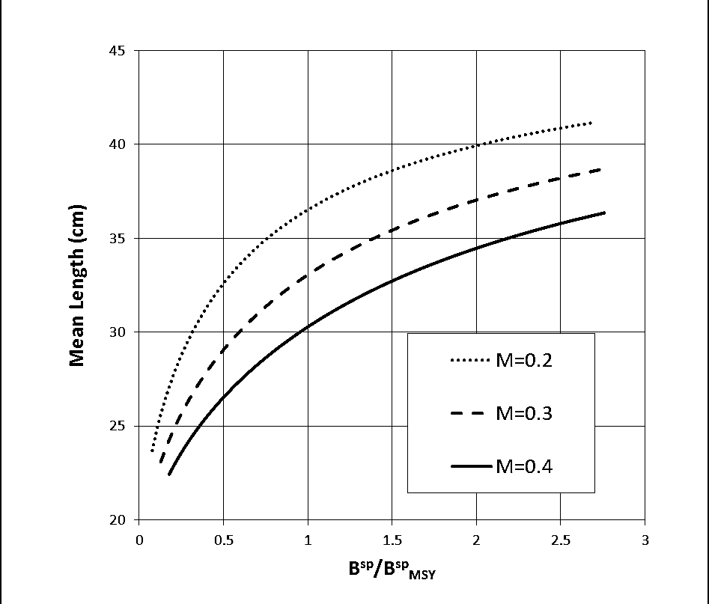
Indirect index of abundance: Mean length of catch
SSB=SSB_{MSY}
Equilibrium mean length of the catch as a function of spawning biomass for different mortality rates.
Note: Indirect index = Lag in feedback at higher biomass levels.
Mean length
SSB/SSB_{MSY}

Slide 31
Operating model (ASPM)
Model uncertainty: parameter distributions
Depletion: B/K: U[0.1,0.3]
Natural mortality rate: M: U[0.2,0.4]
Steepness of S-R: h: U[0.5,0.9]
Process error:
Logistic selectivity-at-age: Log-normal CV=0.4
Beverton-Holt stock-recruitment: Log-normal CV=0.5
Observation error:
Mean length of catch: Log-normal CV=0.25
Index of abundance: Log-normal CV=0.2
Implementation error:
Catch time series: Log-normal CV=0.2

Slide 32
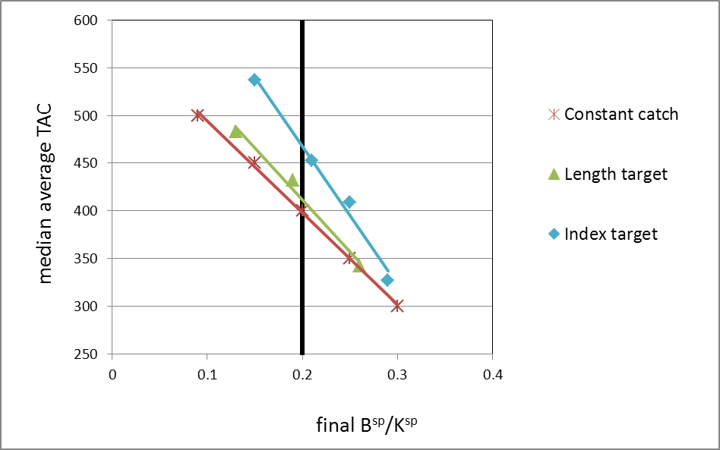
Performance trade-offs: Yield versus risk
Better performance
10%-ile final B^{sp}/K^{sp}
Median average catch plotted against the 10%-ile values for final spawning biomass depletion for alternative tunings of three HCRs.
For same risk: yield for index HCR > mean length HCR >constant catch HCR

Slide 33
Return to fisheries overall:
Why use MSE rather than traditional assessments?
MSE – Management Procedure : Pre-agreed data inputs and HCR
Always check first that you’re likely to end up where you intend
Less time haggling of little long term benefit
Proper evaluation of risk
Sound basis to impose limits on TAC variability
Consistent with Precautionary Principle
Provides framework for interactions with stakeholders, particularly re objectives and trade-offs amongst them
Use haggling time saved towards more beneficial longer term research
PROVIDES DEFAULT

Slide 34
Should MSE always be used?
(whether data-poor or data-rich)
Scenario A
A large quantity of non-conflicting data covering a few decades
An agreed assessment giving estimates of high precision
Few serious uncertainties about assessment assumptions
Little argument about the TAC recommendation to follow from the assessment
No urgency to implement MSE
ARE YOU IN UTOPIA OR DENIAL ??!!

Slide 35
Should MSE always be used?
Scenario B
Few data
Perhaps an historical catch series (accuracy questionable)
No more than a rudimentary:
i) Estimate of abundance in absolute terms; or
ii) Very short series of a relative abundance index
USE A PRECAUTIONARY DATA-POOR METHOD TO PROVIDE ADVICE
(Preferably one subjected to generic simulation testing)
Focus first on developing an improved index of relative abundance before considering MSE

Slide 36
Should MSE always be used?
Scenario C (Minimally, if considering for a specific data-poor/moderate case)
Historical catches, with some idea of their accuracy
A relative abundance index good and long enough plus sufficient biological information to develop at least a simple assessment
Nevertheless assessment results that vary considerably depending on assessment (and data) assumptions that are under debate/dispute
Reasonable certainty that the abundance index will continue to be available for each coming year
IMPLEMENT A CASE-SPECIFIC MSE WITH A SIMPLE HCR
(provided sufficient resources are available)

Slide 37
Does simplicity work?
South Africa
Five high-value data-rich stocks managed on an MP basis, some now for over 20 years
All use simple empirical MPs
Aids with stakeholder understanding and buy-in
Simulation testing based on complex (assessment) models
Europe
North Sea sole (Subarea IV)
Hindsight comparison with what actually happened of applying a simple empirical MP based on a single survey index only

Slide 38
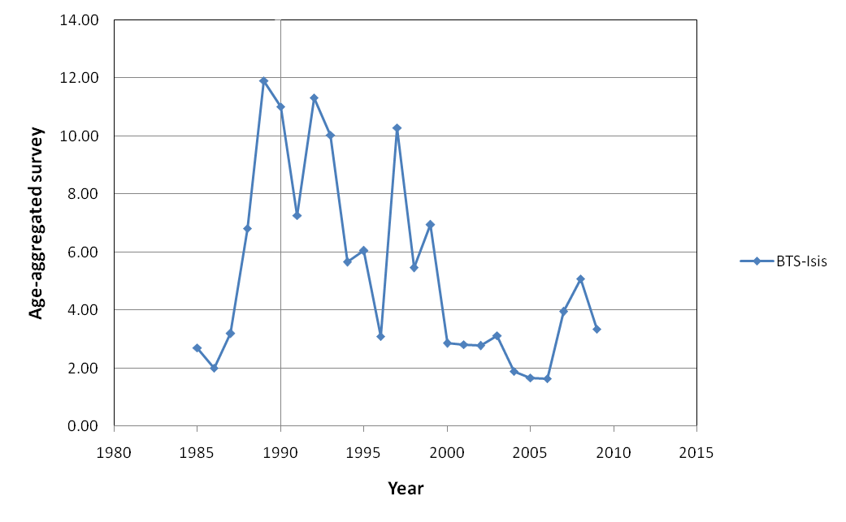
Data: Survey Index
North Sea Sole (Subarea IV)

Slide 39
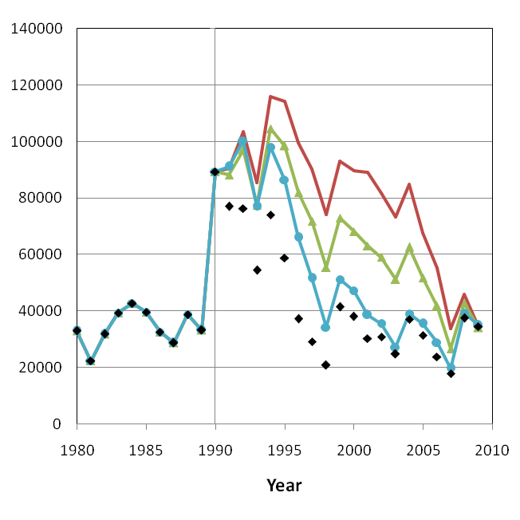
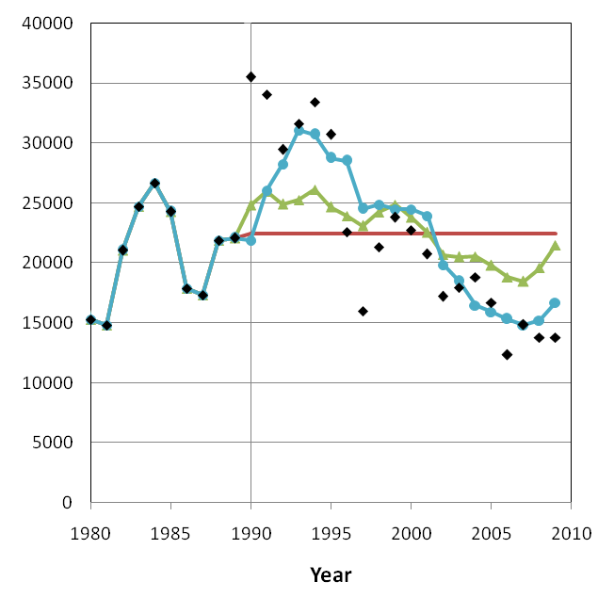
Deterministic hindsight projections
North Sea Sole (Subarea IV)
Constant catch ─
Slope MP ▲
Target MP ●
Observed ♦
Spawning biomass (tons)
Annual catch (tons)

Slide 40
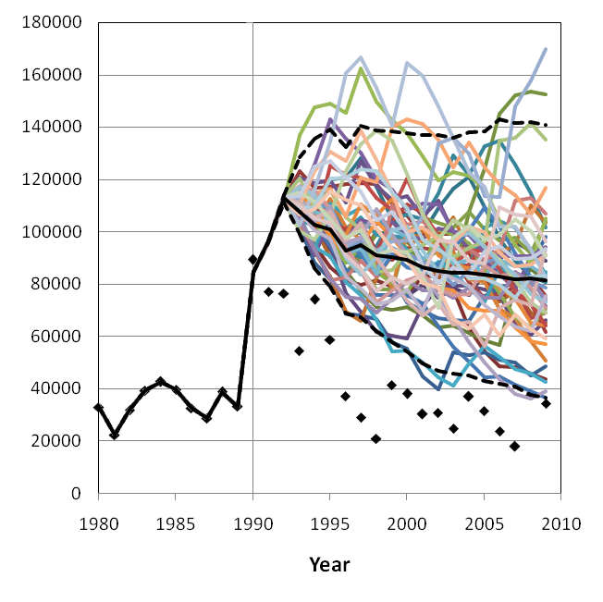
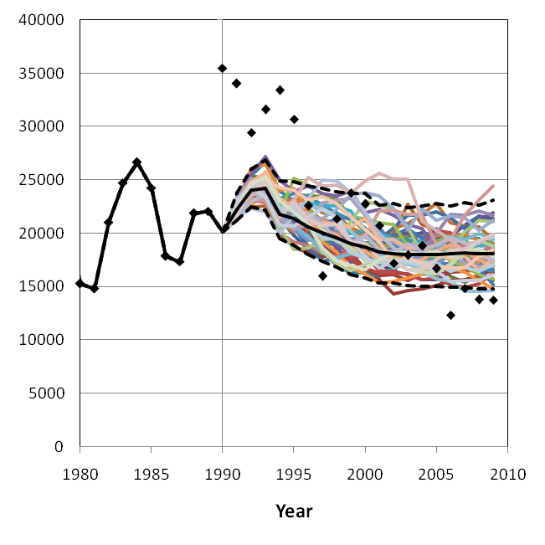

Stochastic forecast projections
North Sea Sole (Subarea IV)
Target MP:
95% PI ---
Median ─
Observed ♦
Spawning biomass (tons)
Annual catch (tons)

Slide 41
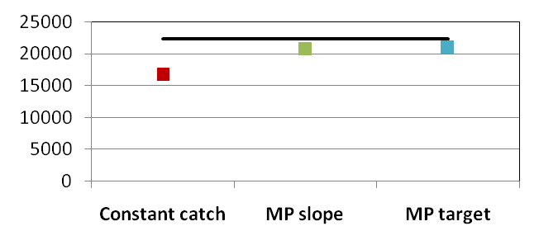
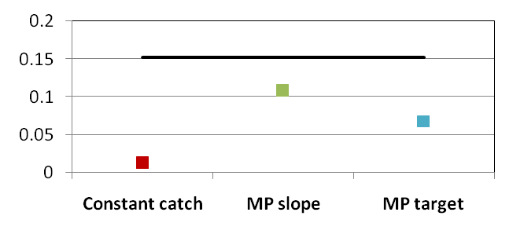
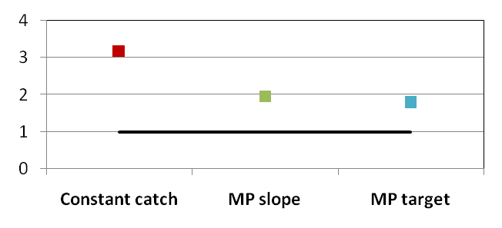
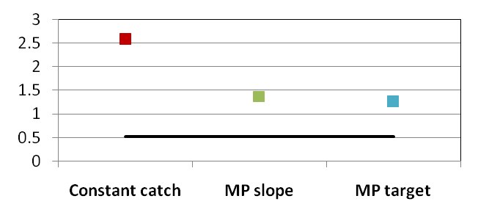
Hindsight projection of forecast MP
North Sea Sole (Subarea IV)
Observed ─
Annual average catch (tons)
Average change in catch
2009 SSB/SSBtarget
min SSB/SSB target

Slide 42
In conclusion
Need a consolidated approach to data-poor management, which includes data-collection
Need control rule with feedback
Adopt an MP approach which includes stakeholders to inform on management objectives and trade-offs.
Abundance index-based HRCs perform best. Develop a simple rule applied to a reliable index
The HCR must be risk-averse to avoid low levels of stock depletion
Target selection (B_{MSY} ) difficult to specify: seek to recover to a previous “acceptable” level of an abundance index

Slide 43
And finally always remember…
K I S S
Keep It Simple Stupid

Slide 44
Thank you for your attention, and to
The National Research Foundation (NRF) of South Africa is thanked for the financial assistance towards research conducted by Dr Geromont to complete her doctoral study. The United Nations Food and Agriculture Organisation (FAO) is also thanked for the financial assistance provided to undertake a review of data-poor methods.
Notes:
44

